Slide 1
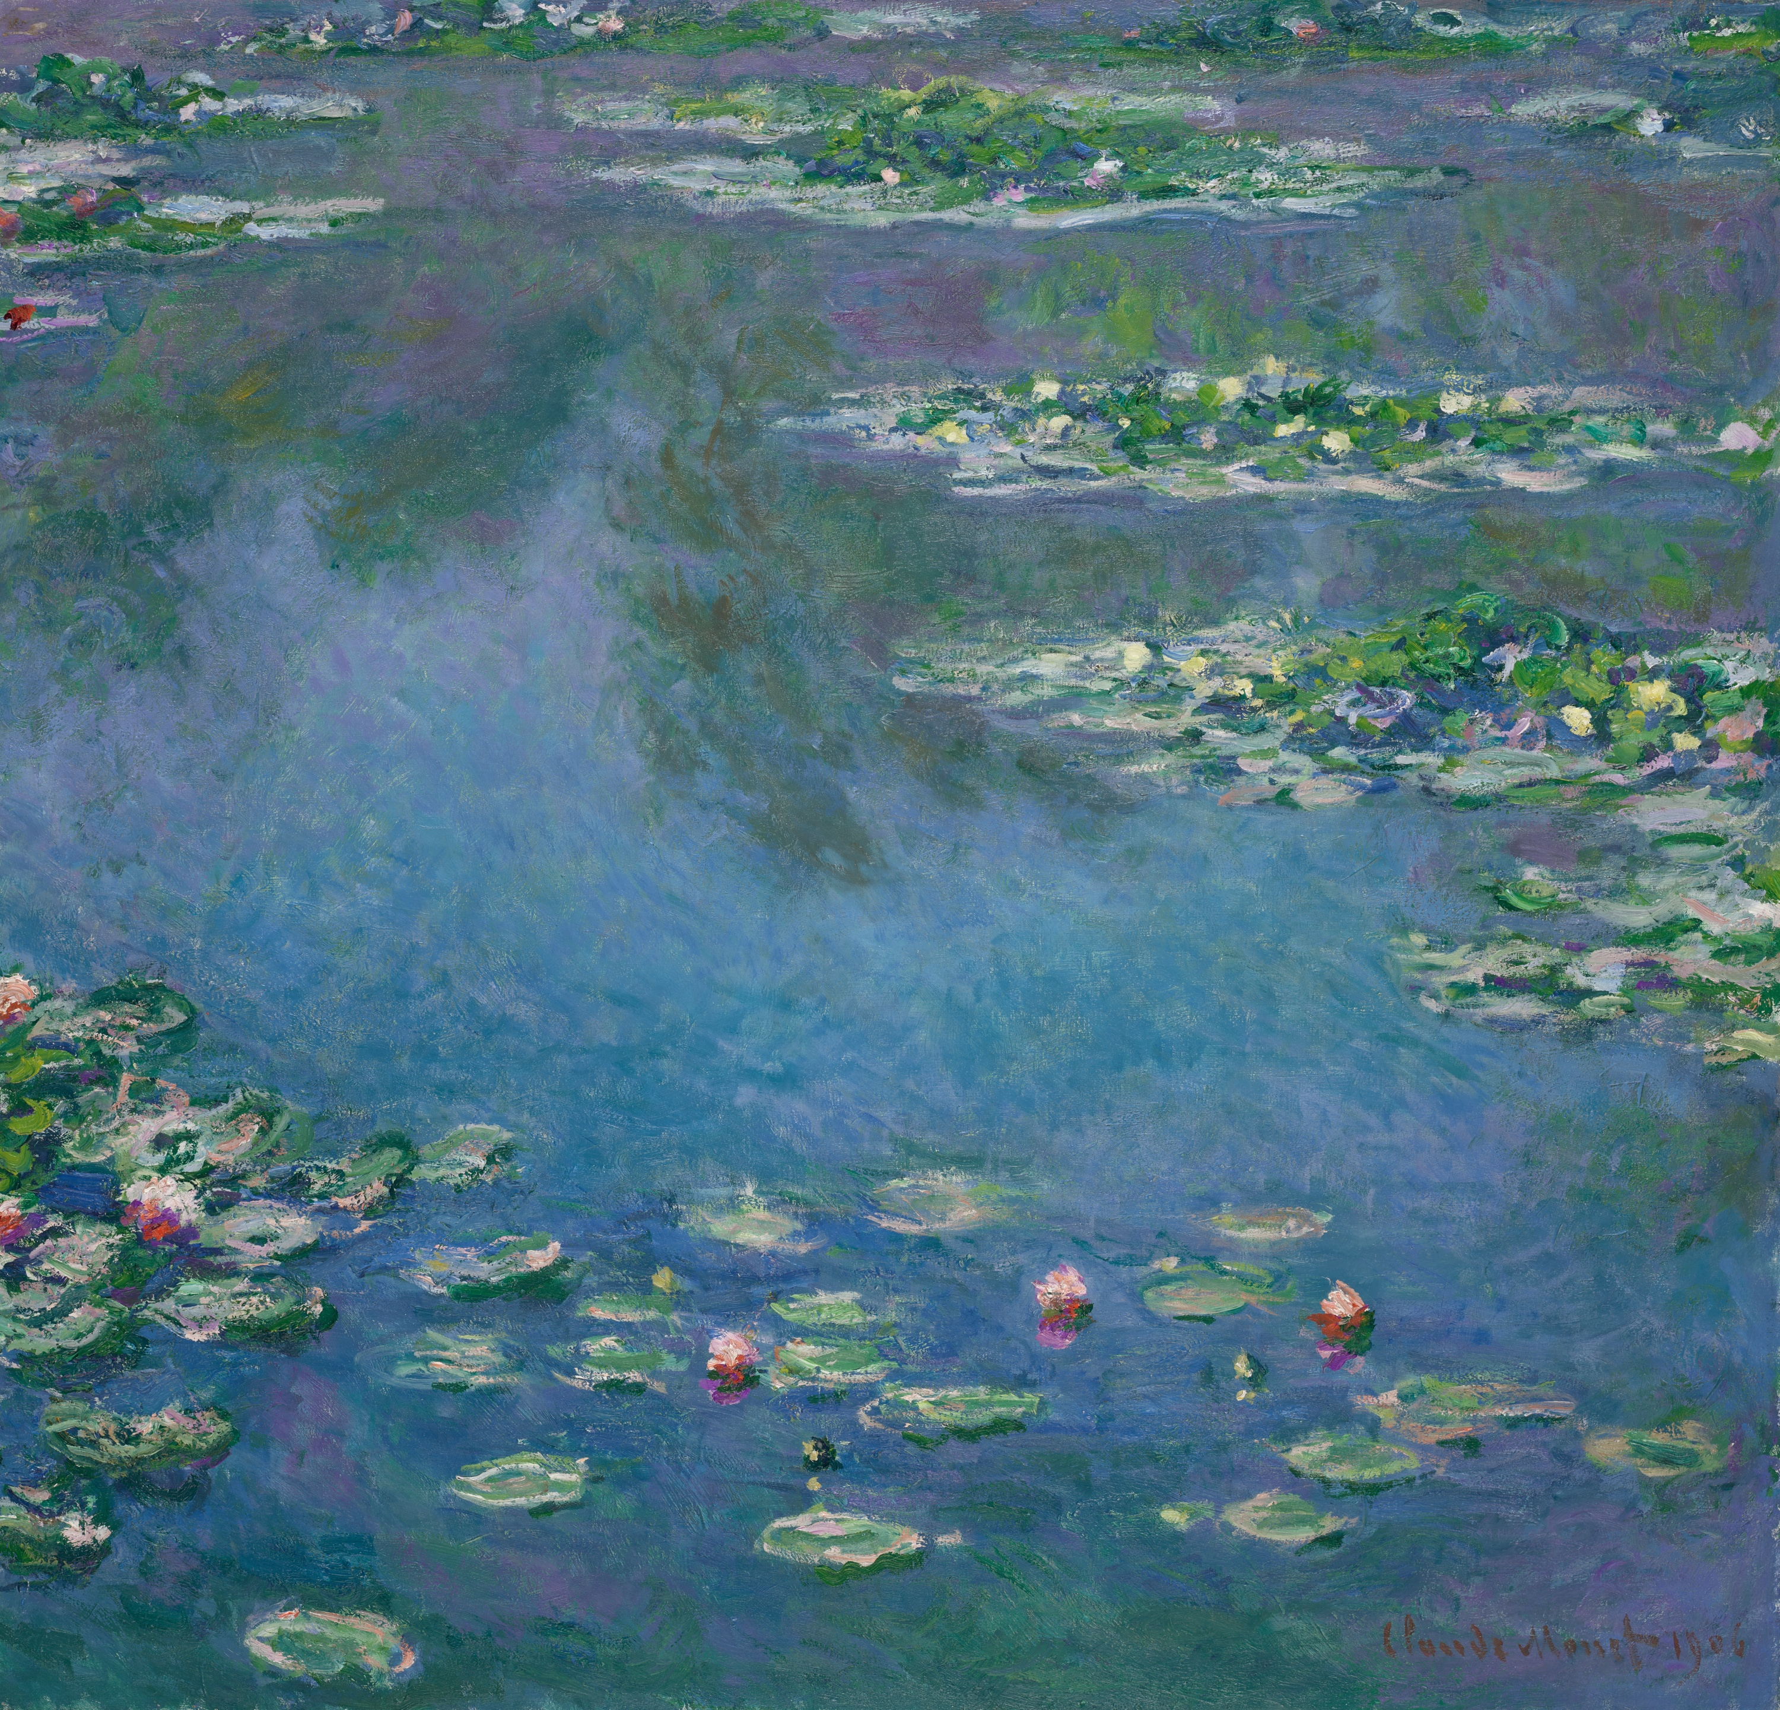
Image recognition of famous Artworks
programmed by
Niclas Mick Günther
Sebastian Wedell
Alexander Sliwinski

Slide 2
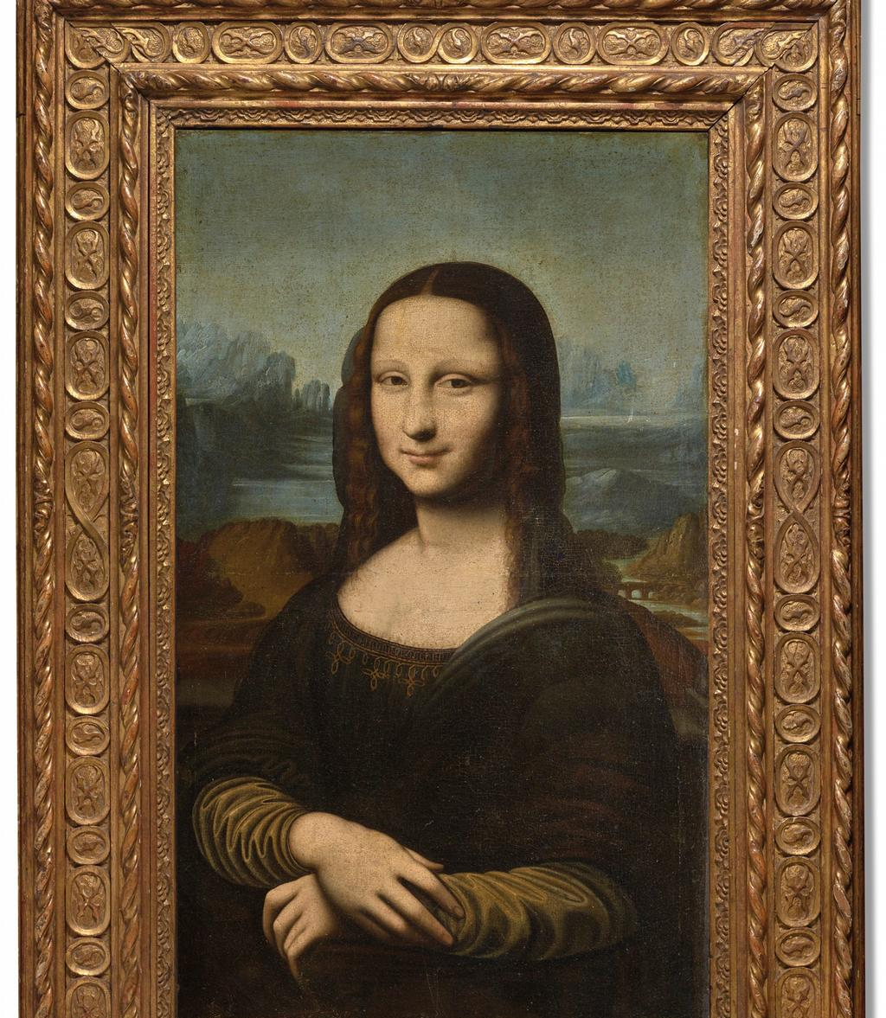


Which dataset we use?
We will use the APIs from the Metropolitan Museum of Art Met Collection,from the Art Institute of Chicago and from the Rijksmuseum in Amsterdam
Maybe we use Web Scraping for e.g. the describing text
The used data is public.
We used selenium to scrape pictures from Google images
The used data is public.
1/3

Slide 3
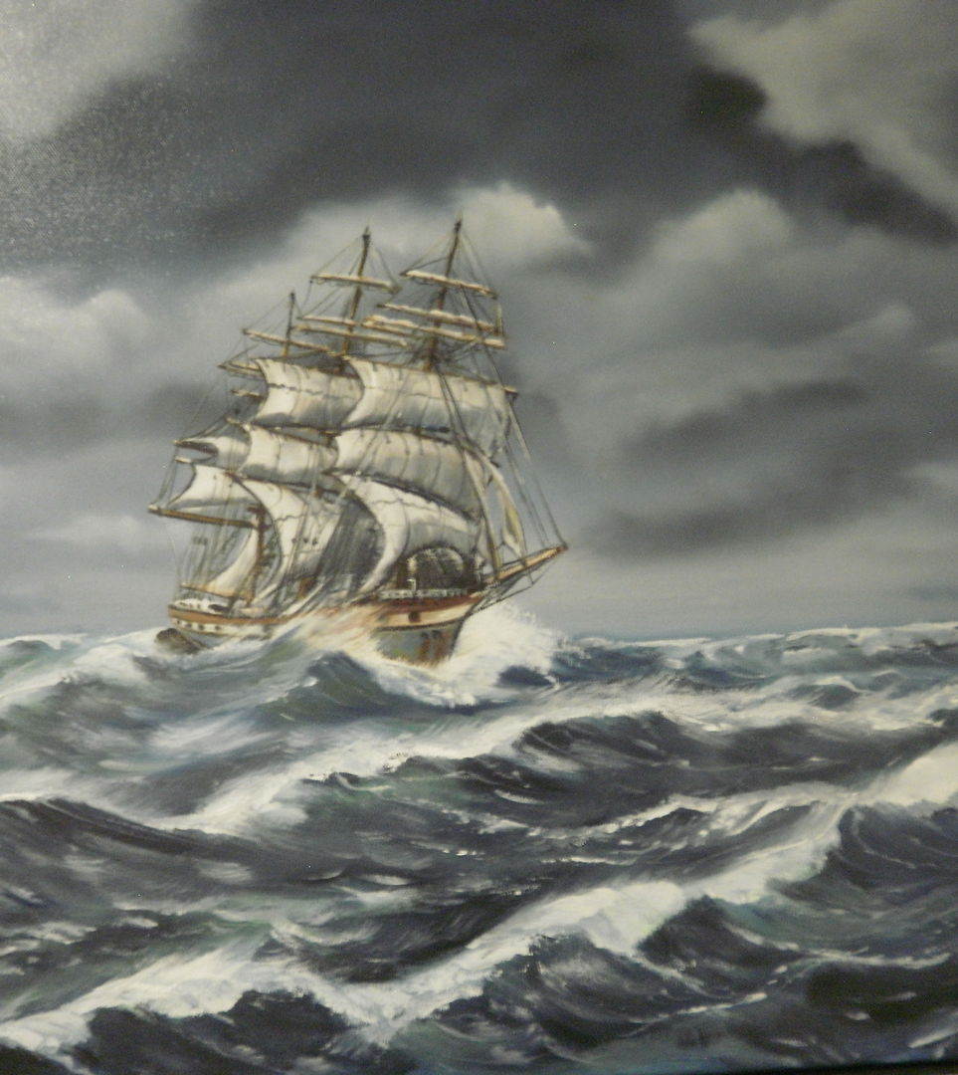
Scraping
Modeling
Predicting
2/3

Slide 4
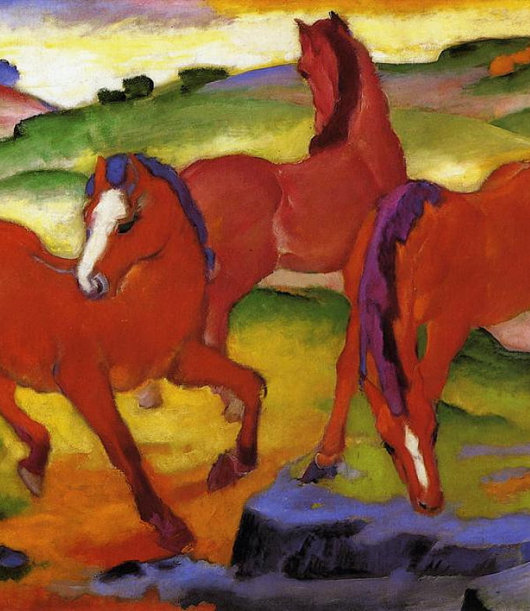
Code on!
3/3

